Slide 1
US ImmigratioN Analysis
Group 6: A team of 4 doing the work of 6
UCI Data Boot Camp Project 2: Group 6 Saeed Pakyari, Max Oteng, Trevor Towers, Scott Leslie

Slide 2
Goals
Design and Deploy a Visualization Engine that provides insight into Immigration profile of the US
A flexible set of options that can answer anybody’s questions
Analyze Immigration across Demographics
Geographically Map Immigration from the World to locations in the US
Perform analysis to describe the Immigration landscape
Provide Conclusions and Recommendations
Notes:
0.5 min

Slide 3
Today’s Agenda
Data Sources/Preparation
Scott
ETL/Webify Data
Saeed
Visualization Features and Functions
Trevor
Analysis
Max
Notes:
0.5 min

Slide 4


DaTA SouRCES*
Migration Policy Institute
Immigration Population by Birth Region/Demographic
Age, Education, Income and Job Type (Sample after merging/cleaning)
Department of Homeland Security
Immigration Population by County from Country (Sample after merging/cleaning) 2007-2018
960,000 Rows after merging, 368,000 after cleanup
Homeland
Security
* Not Including the myriad of ones we didn’t use!
Notes:
1 mins

Slide 5
ETL and Webify the DATa

Slide 6
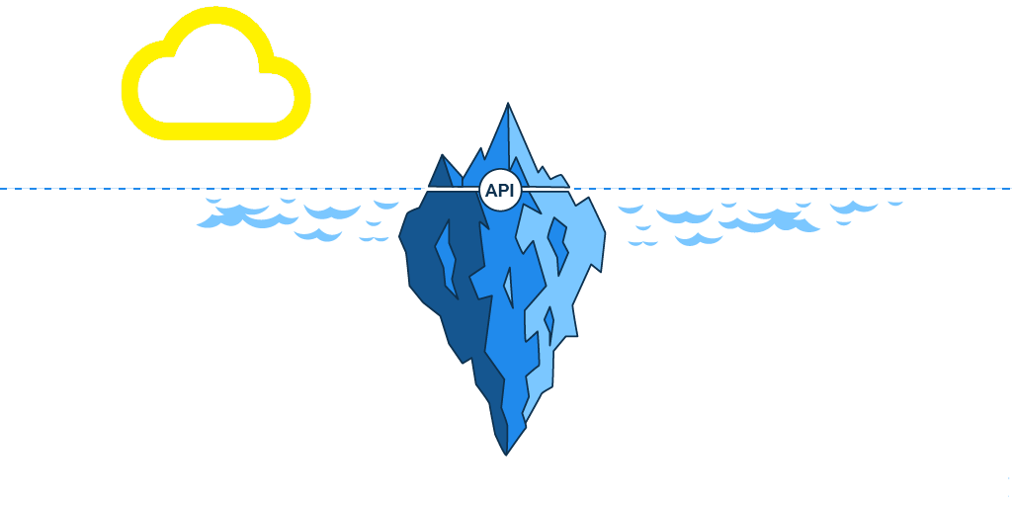

Front-End
Back-End

Slide 7











Server
JSON
Request
Front-End
API
Back-End
E
T
L

Slide 8
API Routes
Input Routes:
4 APIs To be used in the web application’s interactive tools:
/api/v1.0/years
/api/v1.0/countries
/api/v1.0/regions /api/v1.0/admission_classes
Data Routes:
5 APIs to be provide data for JS visualizations:
api/v1.0/migration_data/(demography)
/api/v1.0/immigrants_by_county/(countries or regions)/(years)/(top)
/api/v1.0/immigrants_by_state/(countries or regions)/(years)/(top)
/api/v1.0/diversity_by_state/(locations)/(years)/(top)
Notes:
1 min

Slide 9
Immigrants’ demographics Data
To extract multiple demographics data from the database:
api/v1.0/migration_data/
Demography
Age
Education
Income
Median Income
Income
Occupation
Notes:
1 min

Slide 10
Immigrants’ distribution data
To extract immigrants’ distribution information throughout the USA.
The APIs are designed to the user a variety of options to make customized query.
/api/v1.0/immigrants_by_county/
countries or regions
/years/
/top
/api/v1.0/immigrants_by_state/
Mexico
2010
5
Mexico&India
2010&2015
n
region:Europe
2008:2015
all
all
all
Notes:
1 min

Slide 11
State’s Immigrants diversity
To extract immigrants’ diversity data by state
/api/v1.0/diversity_by_state/
Location
/years/
/top
California
2010
5
Texas
2010&2015
n
all
2008:2015
all
all

Slide 12
Visualization Design

Slide 13
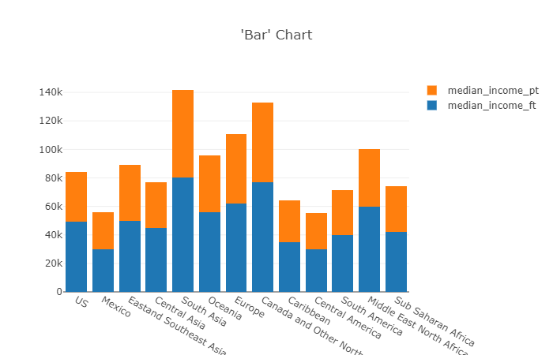
Visualization Design and Function
`http://127.0.0.1:5000/api/v1.0/migration_data/${diversity}`
Notes:
1.5 min

Slide 14
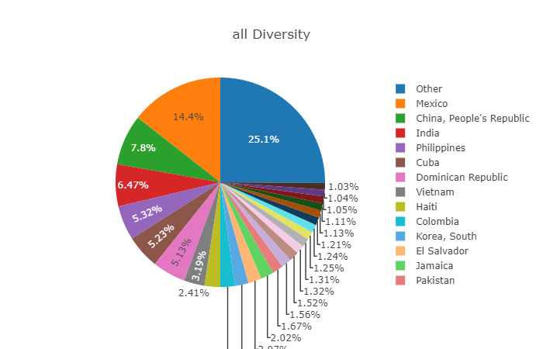
Visualization Design and Function
`http://127.0.0.1:5000/api/v1.0/diversity_by_state/${Location}/all/all`
Notes:
1.5 min

Slide 15
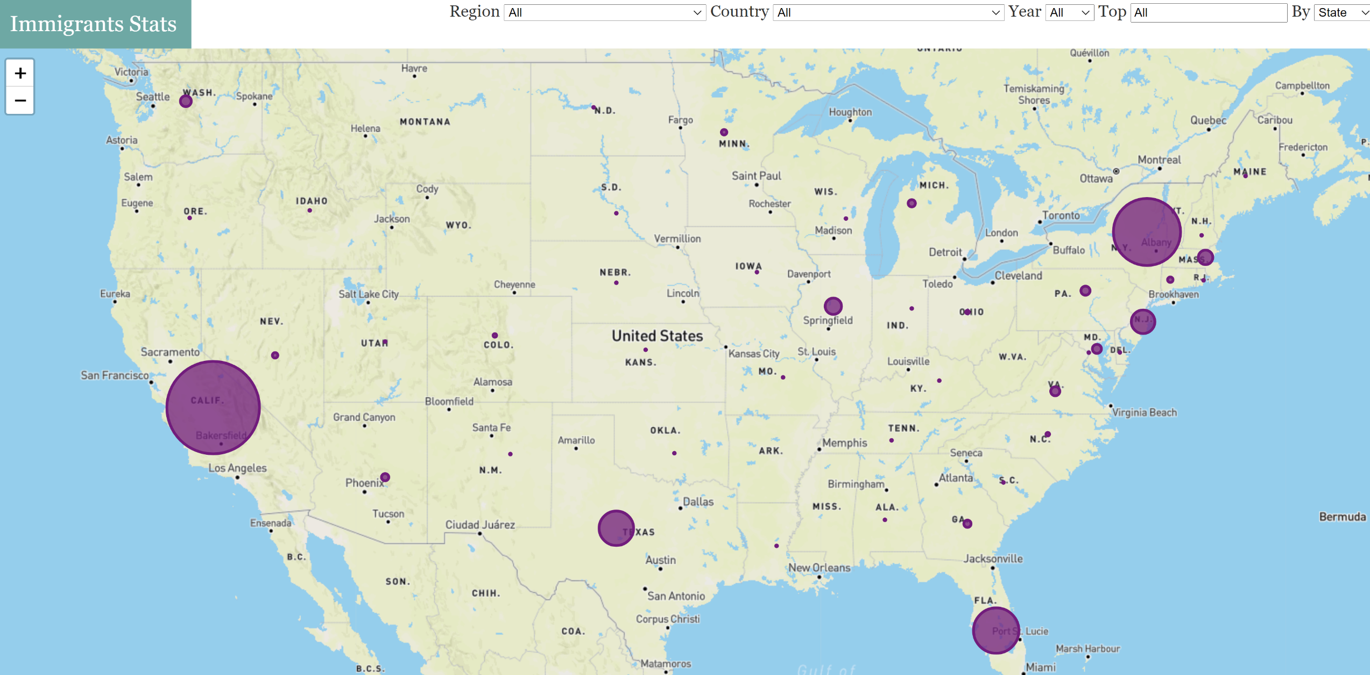
Visualizations

Slide 16
Demonstrations and Analysis
A Bubble Map : Flow
Interactive Bar Charts: Demographic Profiles of Immigrations
Interactive Pie Charts: Diversity of nationality
Notes:
3 mins

Slide 17
Analysis of flow and demographic profiles of immigrants in us
What the visualizations tell us
1. Settlement:
Preferred States: Most settle in California, New York and Florida
Preferred Counties: Los Angeles (CA), Miami-Dade (FL), Cook County(IL), King (WA)
Most widely distributed: Central Asians and Sub-Saharan Africans
Demonstration
Where immigrants from Ghana settle
Notes:
2 min

Slide 18
Demonstration: settlement by county

Slide 19
Demonstration: immigrants from ghana

Slide 20
Analysis of flow and demographic profiles of immigrants in us
What the visualizations tell us
2. Age Demographics:
Most immigrants from Sub Saharan Africa and Asia (Central and South) tend to be younger < 20 yrs
Immigrants from Europe and Canada tend to be relatively older > 20 yrs

Slide 21
Analysis of flow and demographic profiles of immigrants in us
Notes:
1 min

Slide 22
Analysis of flow and demographic profiles of immigrants in us
What do the visualizations tell us
3. Education attainment:
Immigrants tend to have higher education (Bachelor degree and higher) than natural born Americans
South Asian Immigrants tend to have more advanced degrees
Immigrants from Mexico tend to have 2-year college education or lower.

Slide 23
Analysis of flow and demographic profiles of immigrants in us
Notes:
1 min

Slide 24
Analysis of flow and demographic profiles of immigrants in us
What the visualizations tell us
4. Income Demographics
Immigrants tend to have higher education (Bachelor degree and higher) than natural born Americans
South Asian Immigrants tend to have more advanced degrees
Immigrants from Mexico tend to have 2-year college education or lower.

Slide 25
Analysis of flow and demographic profiles of immigrants in us
Notes:
1 min

Slide 26
Analysis of flow and demographic profiles of immigrants in us
What the visualizations tell us
5. Median income:
Majority of immigrants earn more than $48K
About half of Mexican immigrants earn less than $48K
A little more than 40% of immigrants from South Asia earn more than $125k+

Slide 27
Analysis of flow and demographic profiles of immigrants in us
Notes:
1 min

Slide 28
Analysis of flow and demographic profiles of immigrants in us
What the visualizations tell us
5. Job type:
Immigrants from South Asia: Management, Science
Immigrants from Mexico and Central America: Farming, Food services, Cleaning and Transportation
Immigrants from Sub Saharan Africa: Healthcare and Transportation

Slide 29
Analysis of flow and demographic profiles of immigrants in us
Notes:
1 min

Slide 30
Analysis of flow and demographic profiles of immigrants in us
What the visualizations tell us
6. Diversity in Nationality:
US: 14% from Mexico; [top 3: Mexico, China, India]
CA: 20% from Mexico; [top 3: Mexico, China, Philippines]
IL: 24% from Mexico; [top 3: Mexico, India, Poland]
NY/NJ: 16% from Dominican Rep; [top 3: Dominican Rep, China, India]
FL: 16% from China; [top 3 are China, Columbia, Venezuela]

Slide 31
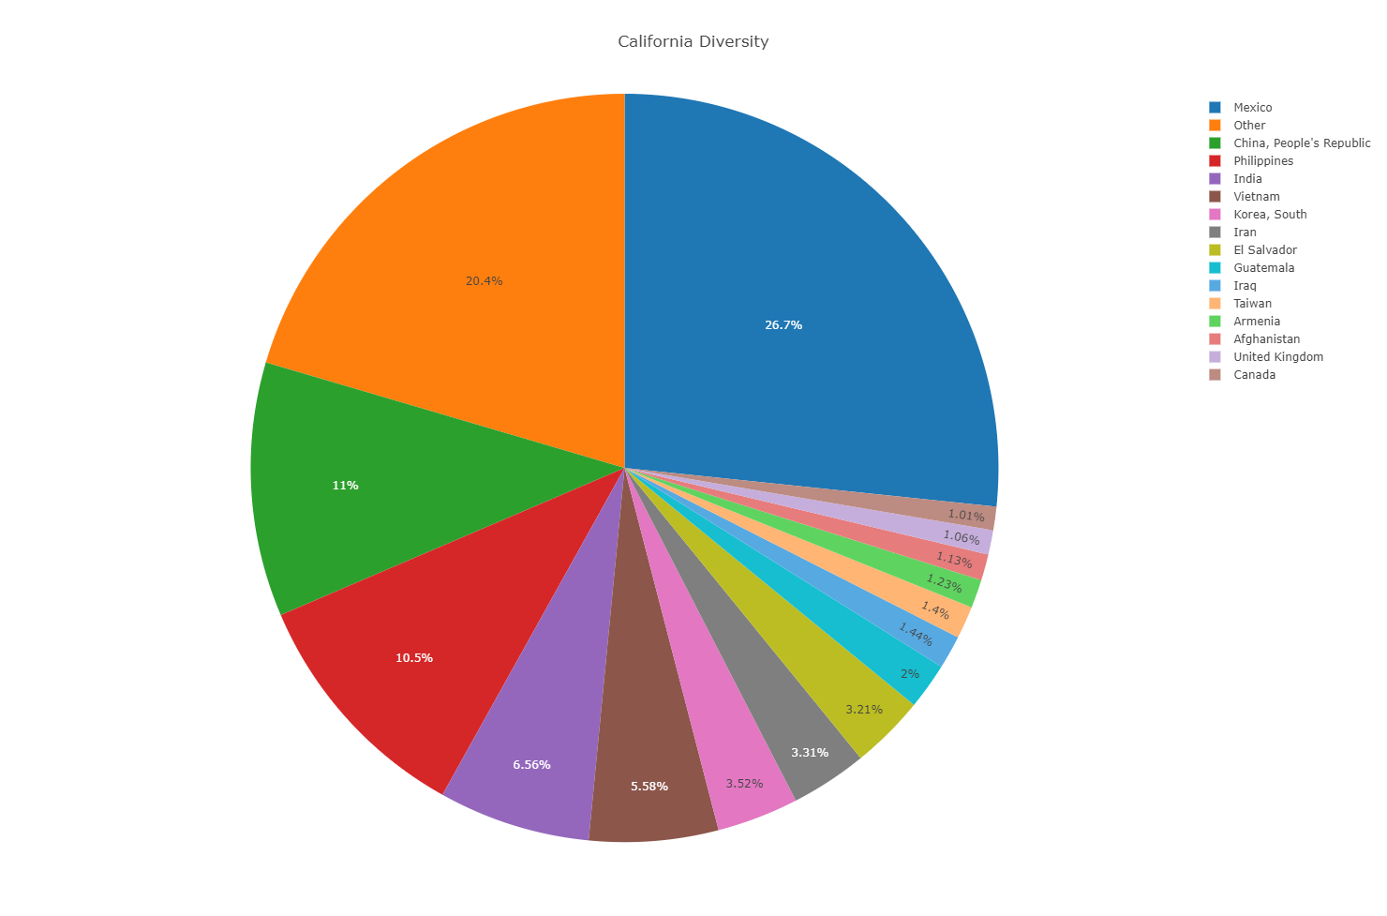
Analysis of flow and demographic profiles of immigrants in us

Slide 32
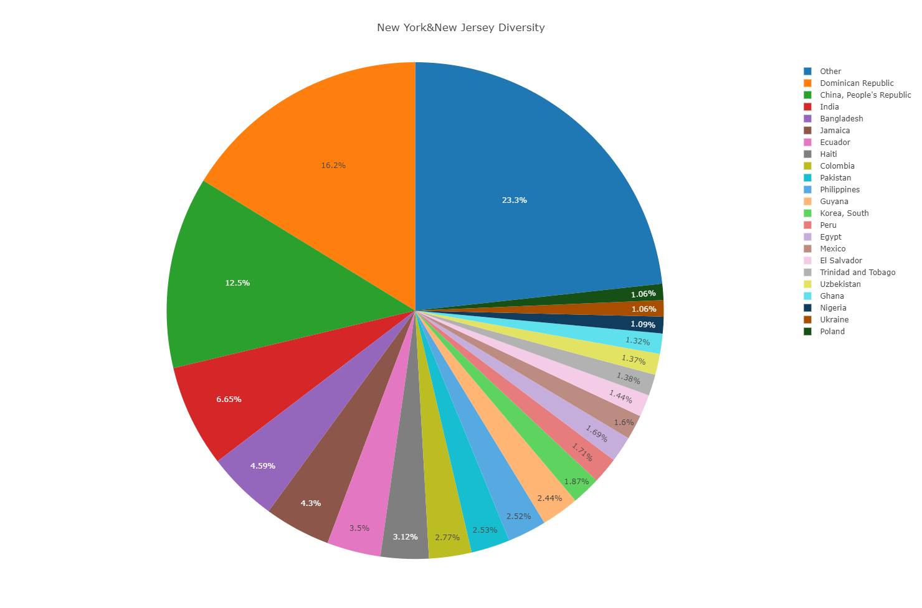
Analysis of flow and demographic profiles of immigrants in us

Slide 33
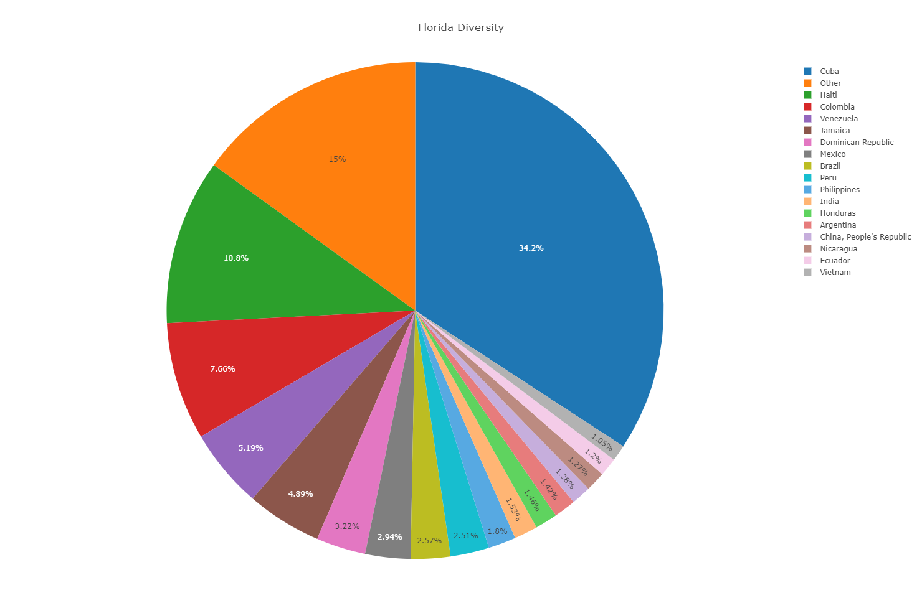
Analysis of flow and demographic profiles of immigrants in us

Slide 34
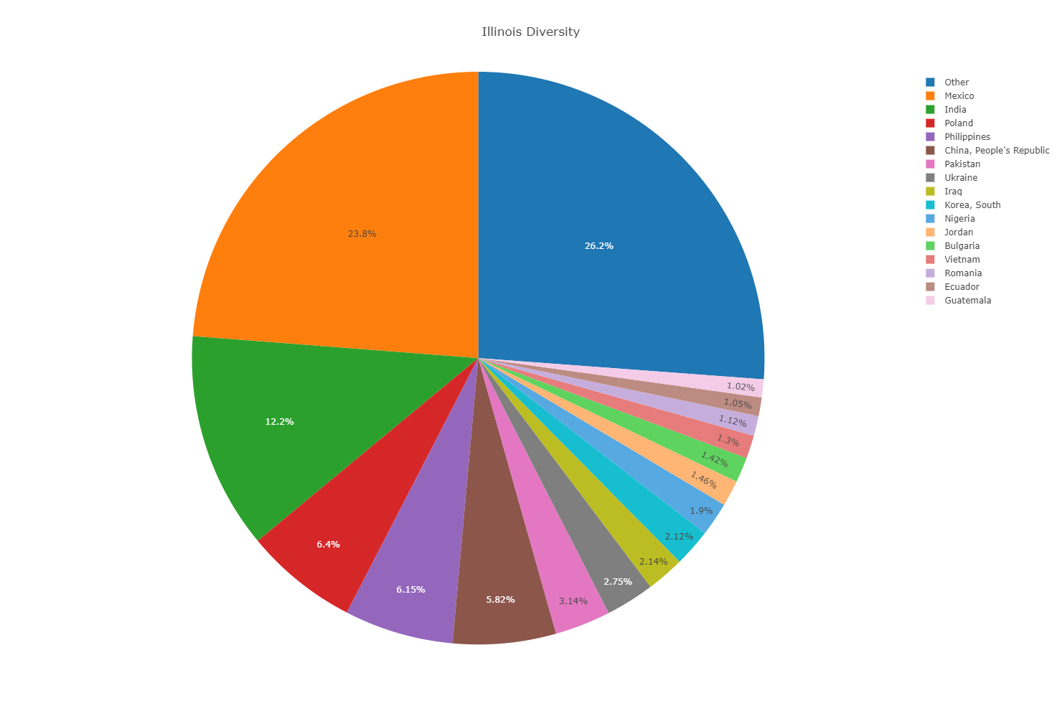
Analysis of flow and demographic profiles of immigrants in us

Slide 35
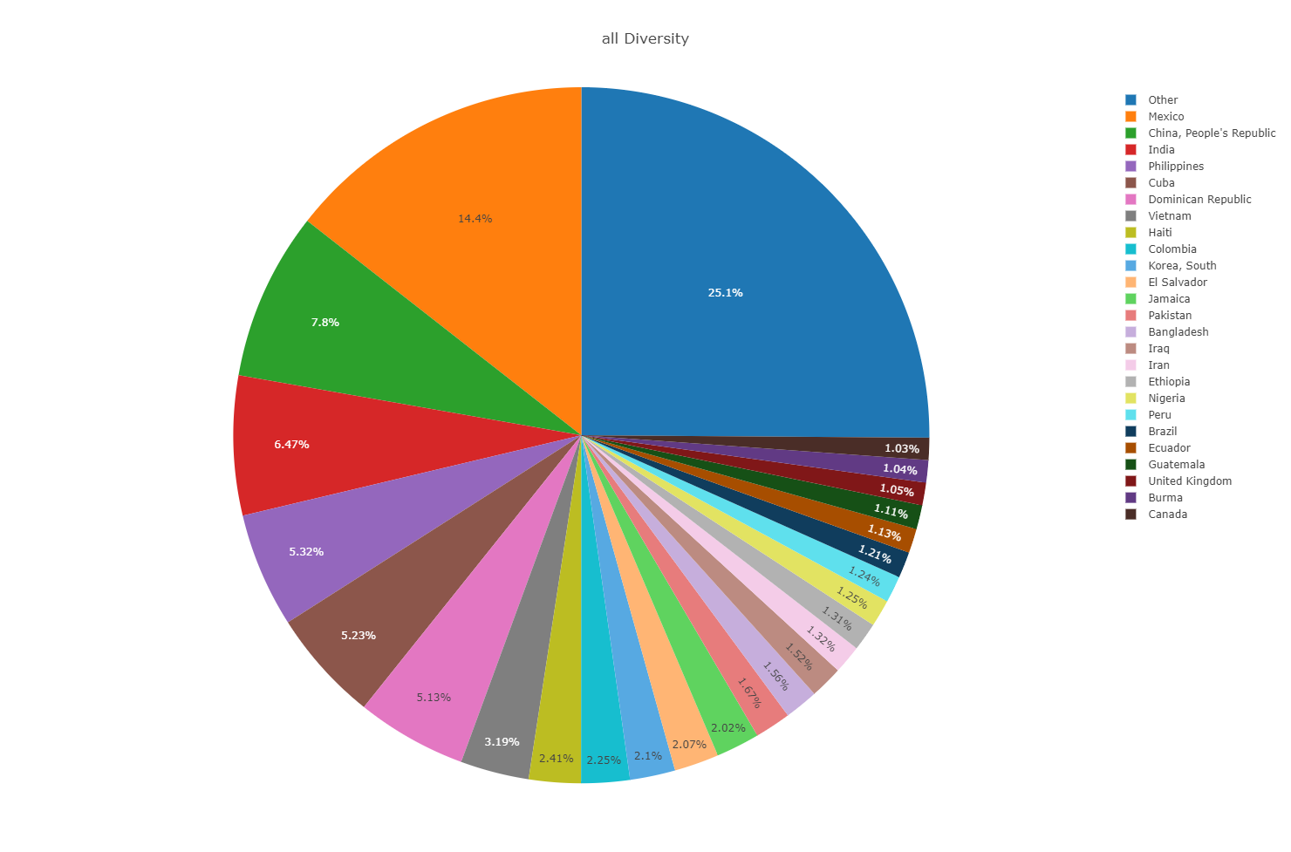

Slide 36
Conclusions
What we did:
Analyze the flow and selected demographic profiles of immigration to the US
Approach:
Interactive visualizations: Bubble Map, Bar Charts and Pie Charts
Tools and techniques: Javascript, Flask Alchemy, PostgreS, D3, Leaflet
Future project
Add heat map to bubble chart
Beautify the website
Advanced interactivity of our visual charts.
Notes:
1 min

